Slide 1
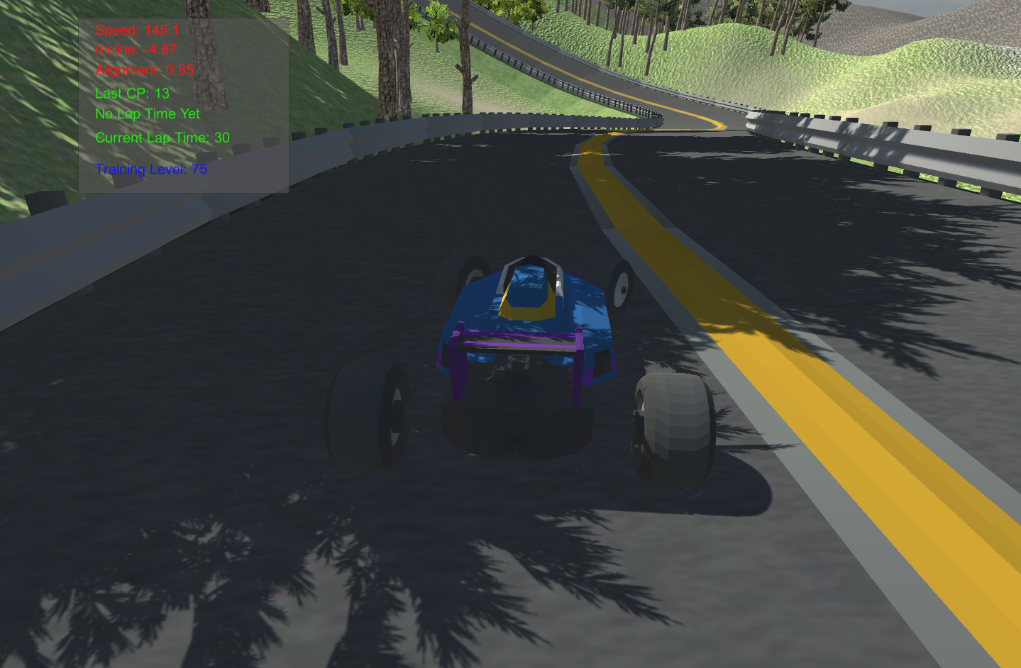


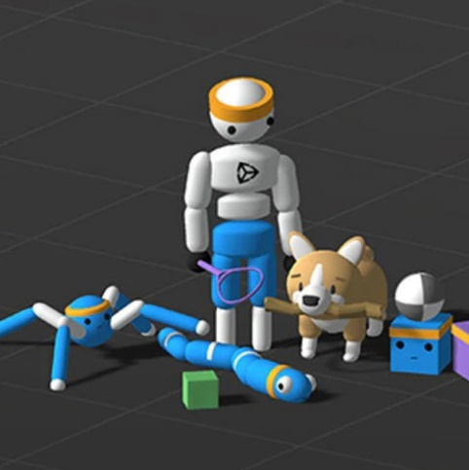
ML Agents Learn to Race at Spa
Charles – Watch this Video and Learn from it !

Slide 2
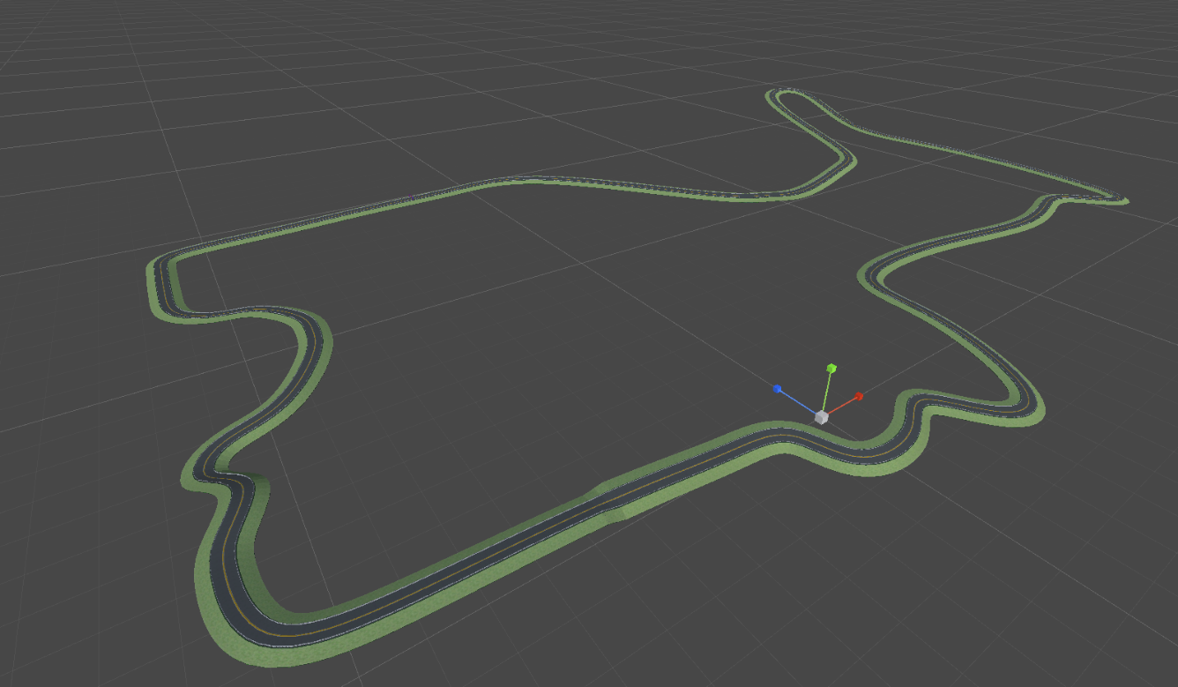
A SPA NurburgRing Style Race Track
The canonical use of ML Agents (Reinforcement learning) to learn Race Car driving dynamics
Inspired by Code Monkey’s AI Car Drive Example https://www.youtube.com/c/CodeMonkeyUnity
However I wanted to train against more challenging longer circuits with slopes and inclines (c.f. The challenging Nurburgring and Spa Tracks, as opposed to the tediously flat Silverstone and modern circuits)
Race Track (and Barriers) Created in Blender
Race Segment + Array & Curve Modifiers
.FBX Model Imported Into Unity
Race Track + Barriers : Mesh Colliders
Unity Terrain, Trees and building feature models added for some track side scenery
Race car modelled with Unity wheel collider dynamics
Rear wheel (collider) propulsion torque
Front wheel (collider) steer
This provides lots of under steer and sliding dynamics
My own Best Lap Time Performance, under Manual control with some practice: ~ 150 seconds

Slide 3
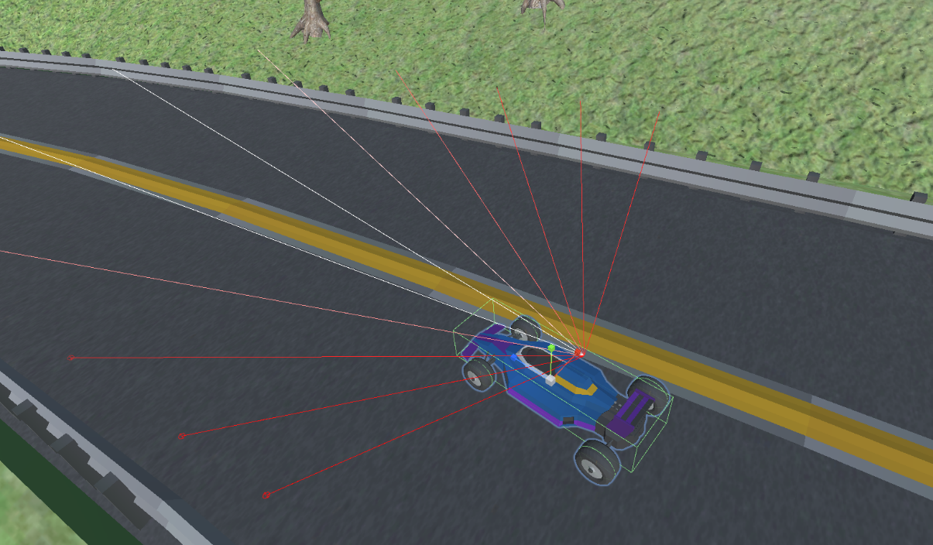
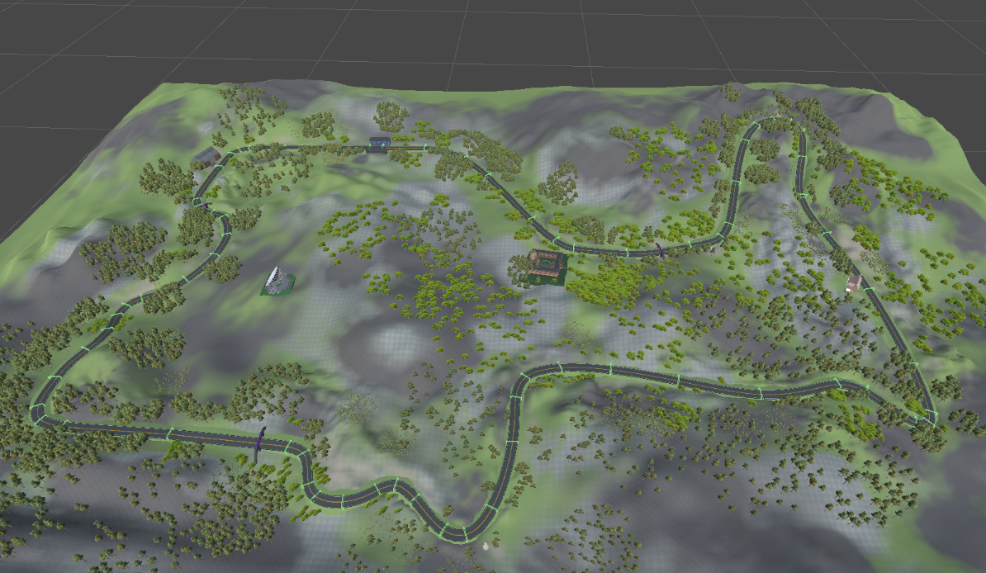
Race Car ML Agent Capabilities
Observation Sensors :
3D Ray perception Sensor: Barriers.
Scalars: Speed, Track Alignment, Track Incline
Actions:
Branch 1: NOOP, Forward Torque, Braking/Reverse Torque
Branch 2: NOOP, Steer Right, Steer Left
Rewards Profile
+1.0 – 0.5* (LapTime / MaxLapTime) - Upon Successful Lap/ Final Check point (End Episode)
-1.0 if the agent runs exceeds MaxLapTime (End Episode)
-0.025 per barrier collision
Unity Machine Learning Reinforcement Machine Learning Training Configuration:
70x Check Point Colliders distributed around Track – As per Code Monkey example Code Monkey: AI learns to Drive Car
Core Proximal Policy Optimization (PPO) based Reinforcement learning
GAIL Imitation Learning against 10x Partial Lap Demonstration recordings (Strength 0.25)
Incremental Training Levels (Slowly Increase Length of Lap)
Increase from Single: Reach Check Point 1
Through to whole Lap, Progress through all 70 Check points
Increase Training level: Lap Length, upon 20 Successive Successful Laps, Decrement Training level upon 10x Failed Laps

Slide 4
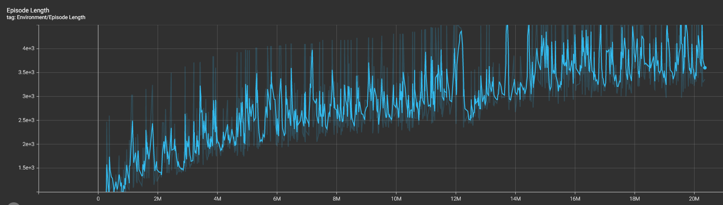
Some Time Later : Final Trained Behaviour
After around 20 Million Episodes the Agent Learns a pretty consistent full lap performance
The Agent is able to complete the Lap in around 160 seconds, some 10 seconds slower than i am able to achieve.

Slide 5
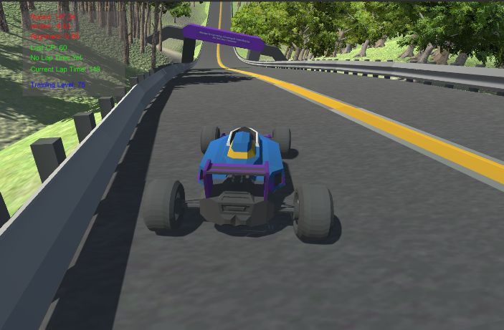
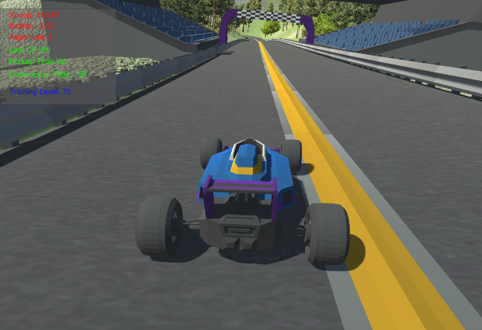

The project code and further technical discussions can be found on GitHub at:
https://github.com/JulesVerny/MLAgnetsAtSpa
Acknowledgements:
Blender: 3D Modelling : https://www.blender.org/
Unity: Game Development : https://unity.com/
Code Monkey Unity and ML –Agent Tutorials: https://www.youtube.com/c/CodeMonkeyUnity
Imphenzia: 3D Blender Modelling : https://www.youtube.com/c/Imphenzia
Sound Track: Fleetwood Mac: “ The Chain “ : https://www.fleetwoodmac.com

